Slide 1
CA LAB (12) RELAY

Slide 2
Switches
An electrical switch is any device used to interrupt the flow of electrons in a circuit. Switches are essentially binary devices: they are either completely on (“closed”) or completely off (“open”).

Slide 3

Simple Switch

Slide 4
Problem
These simple switches required human intervention or some kind of external force to operate.

Slide 5
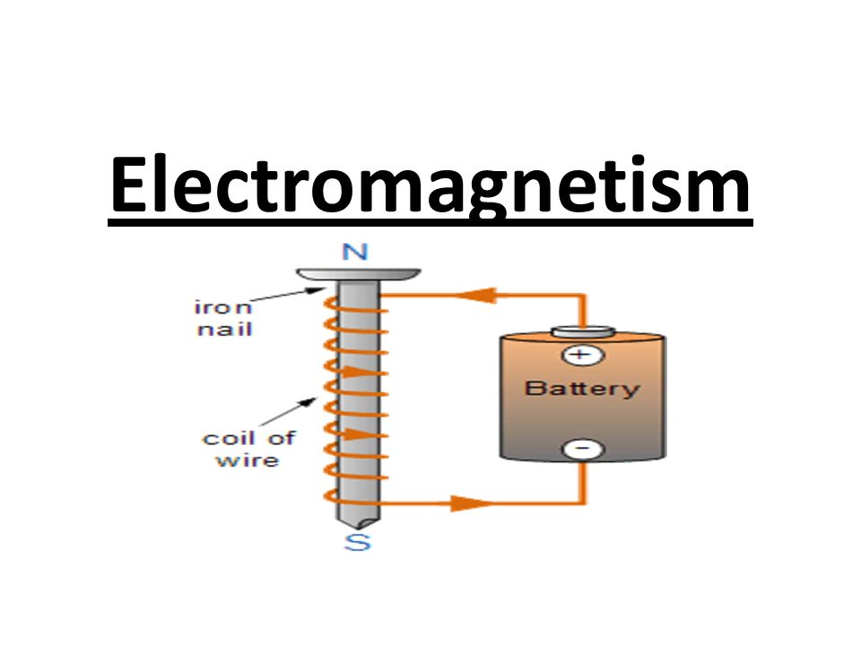

Slide 6
Electromagnetism
Electromagnetism is produced when an electrical current flows through a simple conductor such as a length of wire or cable, and as current passes along the whole of the conductor then a magnetic field is created along the whole of the conductor.
The magnetic field attract or repel magnetic material.

Slide 7
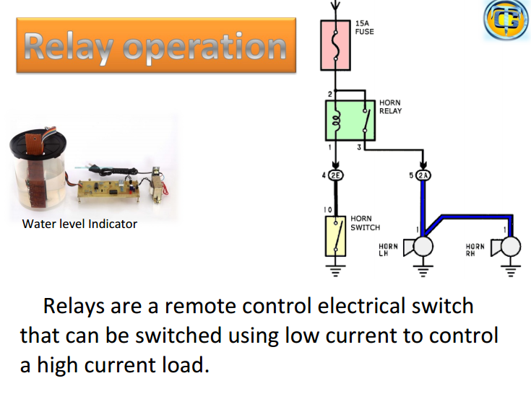

Slide 8
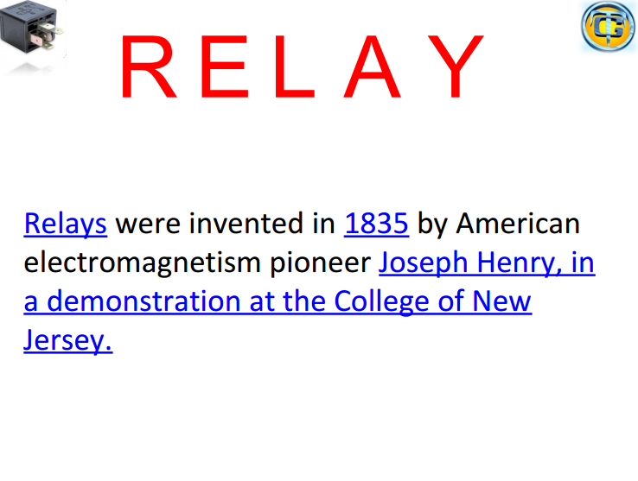

Slide 9
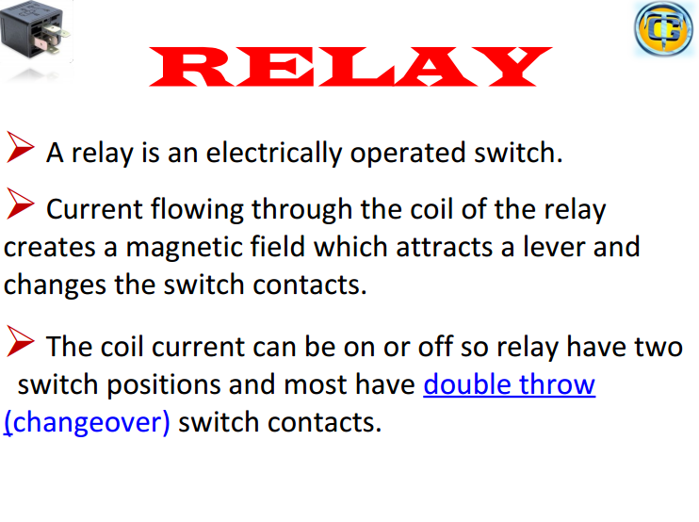

Slide 10
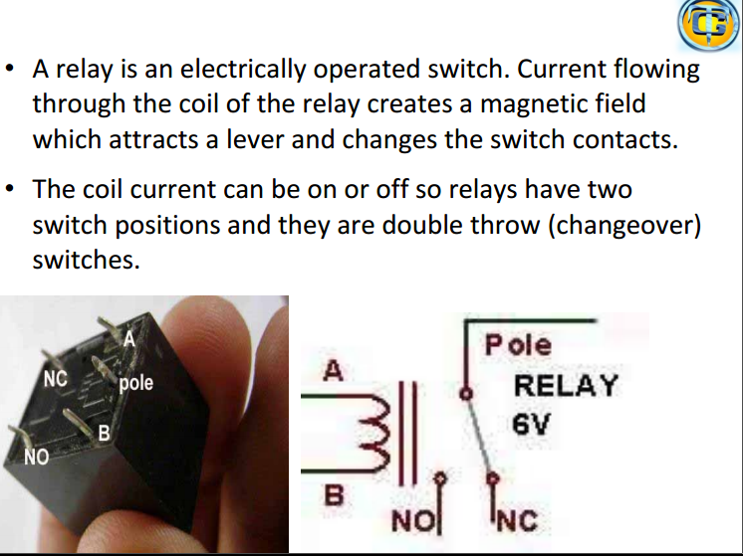

Slide 11
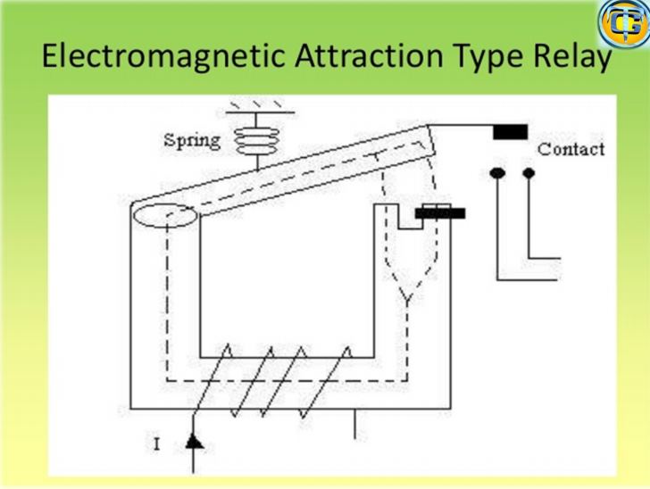

Slide 12
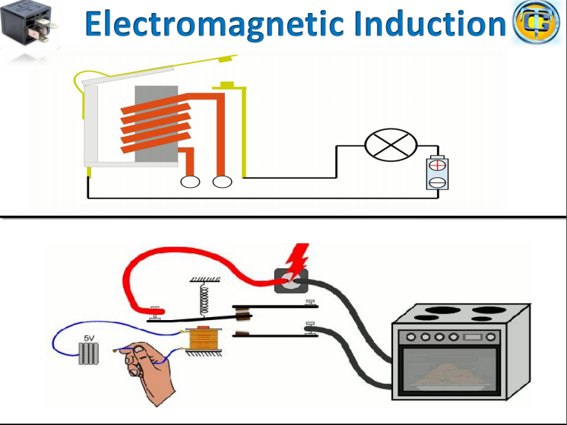

Slide 13
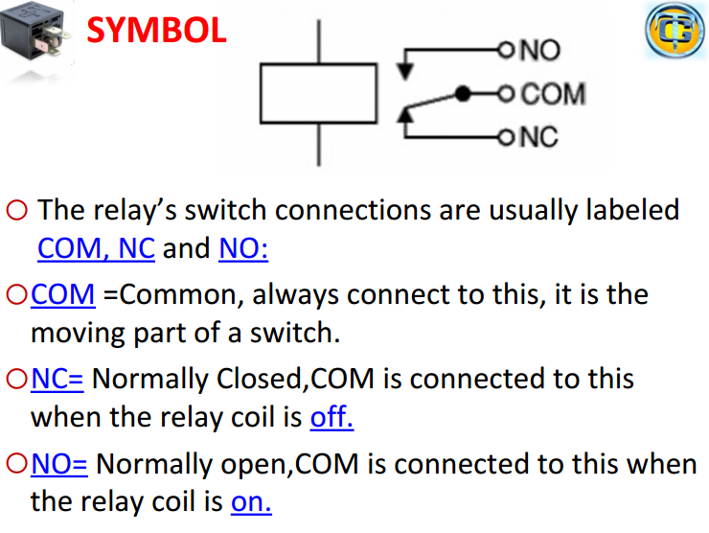

Slide 14
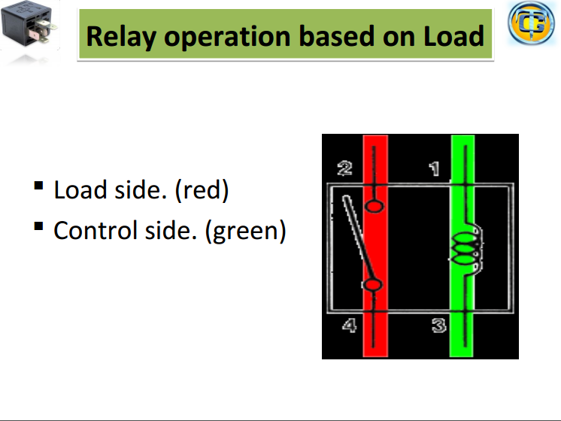

Slide 15
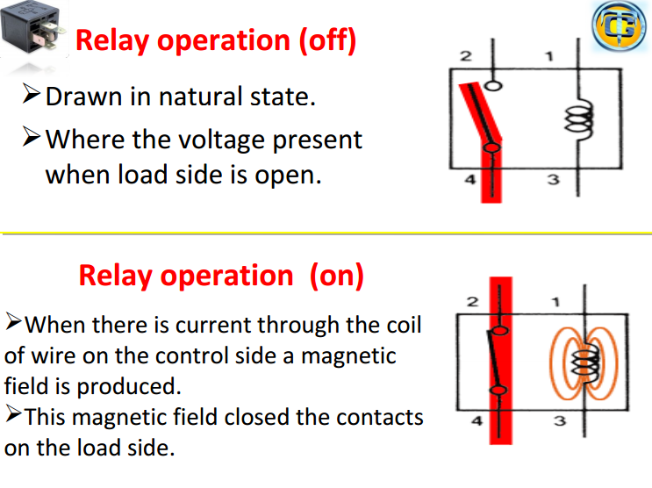

Slide 16
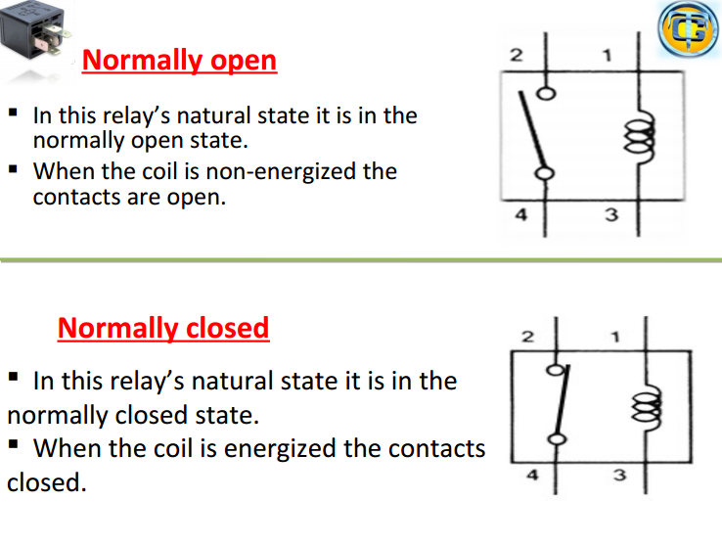

Slide 17
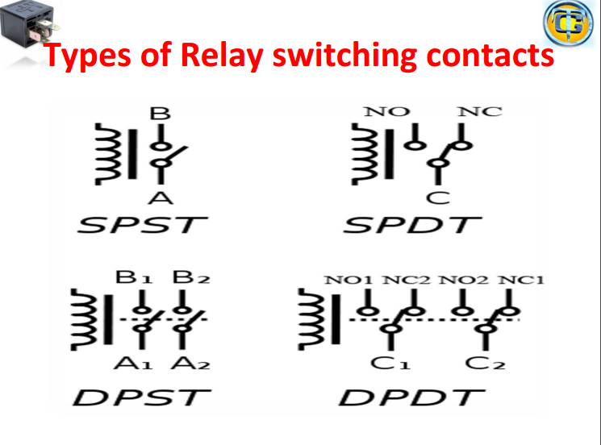

Slide 18
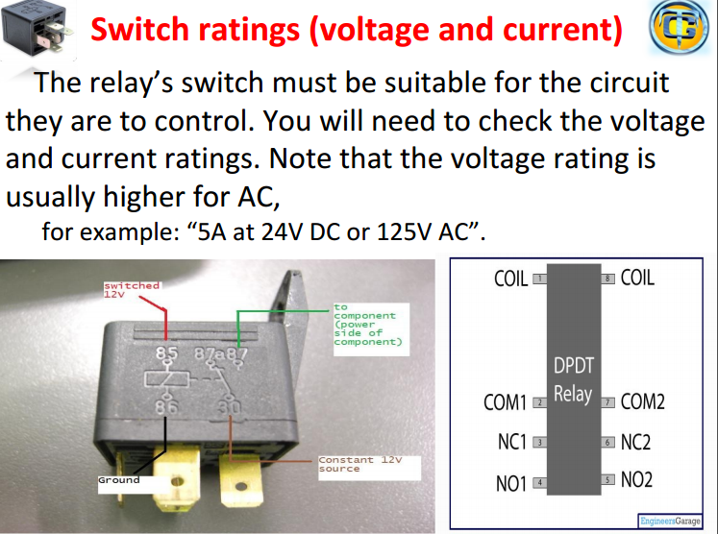

Slide 19
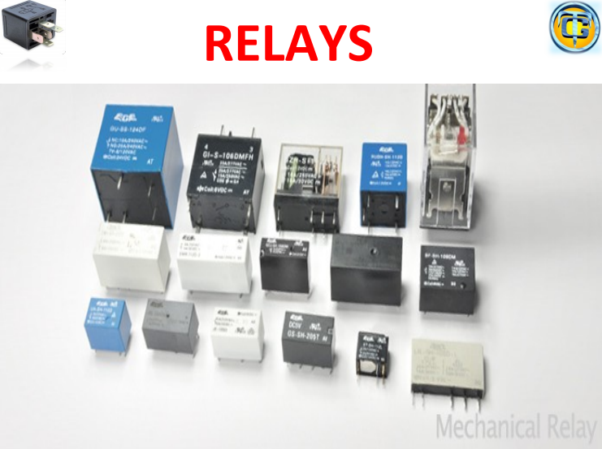

Slide 20


Slide 21
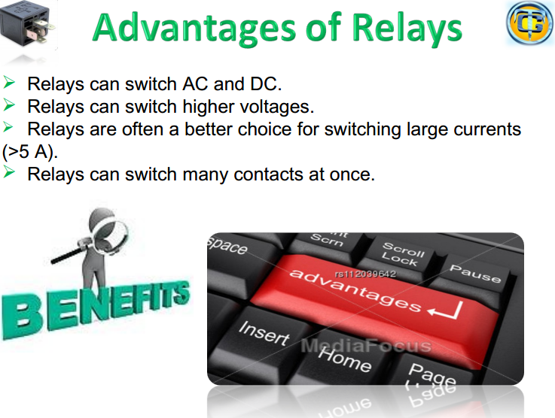

Slide 22
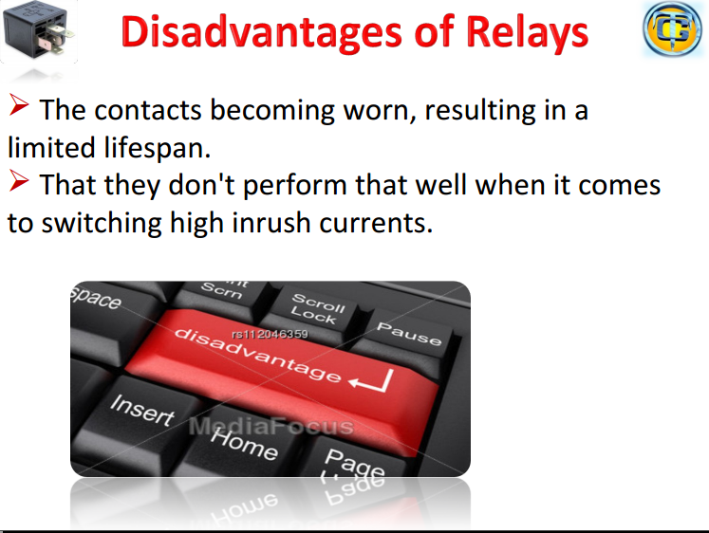

Slide 23
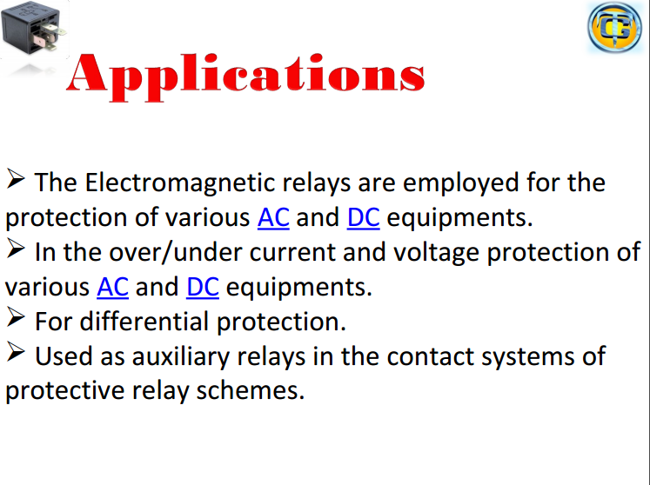

Slide 24


